Slide 1
Akshaykala AI Studio
Presented by Sankalp Samarth
Generative AI Engine for Fashion Mockup Synthesis

Slide 2
Introduction
Background
Jewelry is one of the highest-consideration purchases in e-commerce. A customer cannot feel the weight or hold it up to their ear. The product image is the product. For a brand releasing hundreds of SKUs per season, every single one needs a clean product shot, a lifestyle shot, and an on-model shot. That visual pipeline is the difference between a listing that converts and one that does not.
Problem Statement
The industry standard for producing those images is a traditional studio photoshoot — models, lighting rigs, photographers, post-production editors. For a brand like AkshayKala, this means thousands of rupees per session, days of turnaround time per batch, and a pipeline that simply cannot keep up with catalogue growth. At 50 SKUs it is manageable. At 500, it is a crisis. Cost scales linearly, speed does not improve, and visual consistency across sessions is impossible to guarantee.
Sankalp Samarth
AkshayKala AI Studio

Slide 3
Solution
An automated, containerized Computer Vision and Generative AI pipeline.
Input
Output
The output consists of the earrings in 3 different images:
Raw Earring Photos
Unedited Backgrounds
Input: ".zip" file
AkshayKala AI Engine
White background
Abstract background
Photorealistic On-Model Mockup
Sankalp Samarth
AkshayKala AI Studio

Slide 4
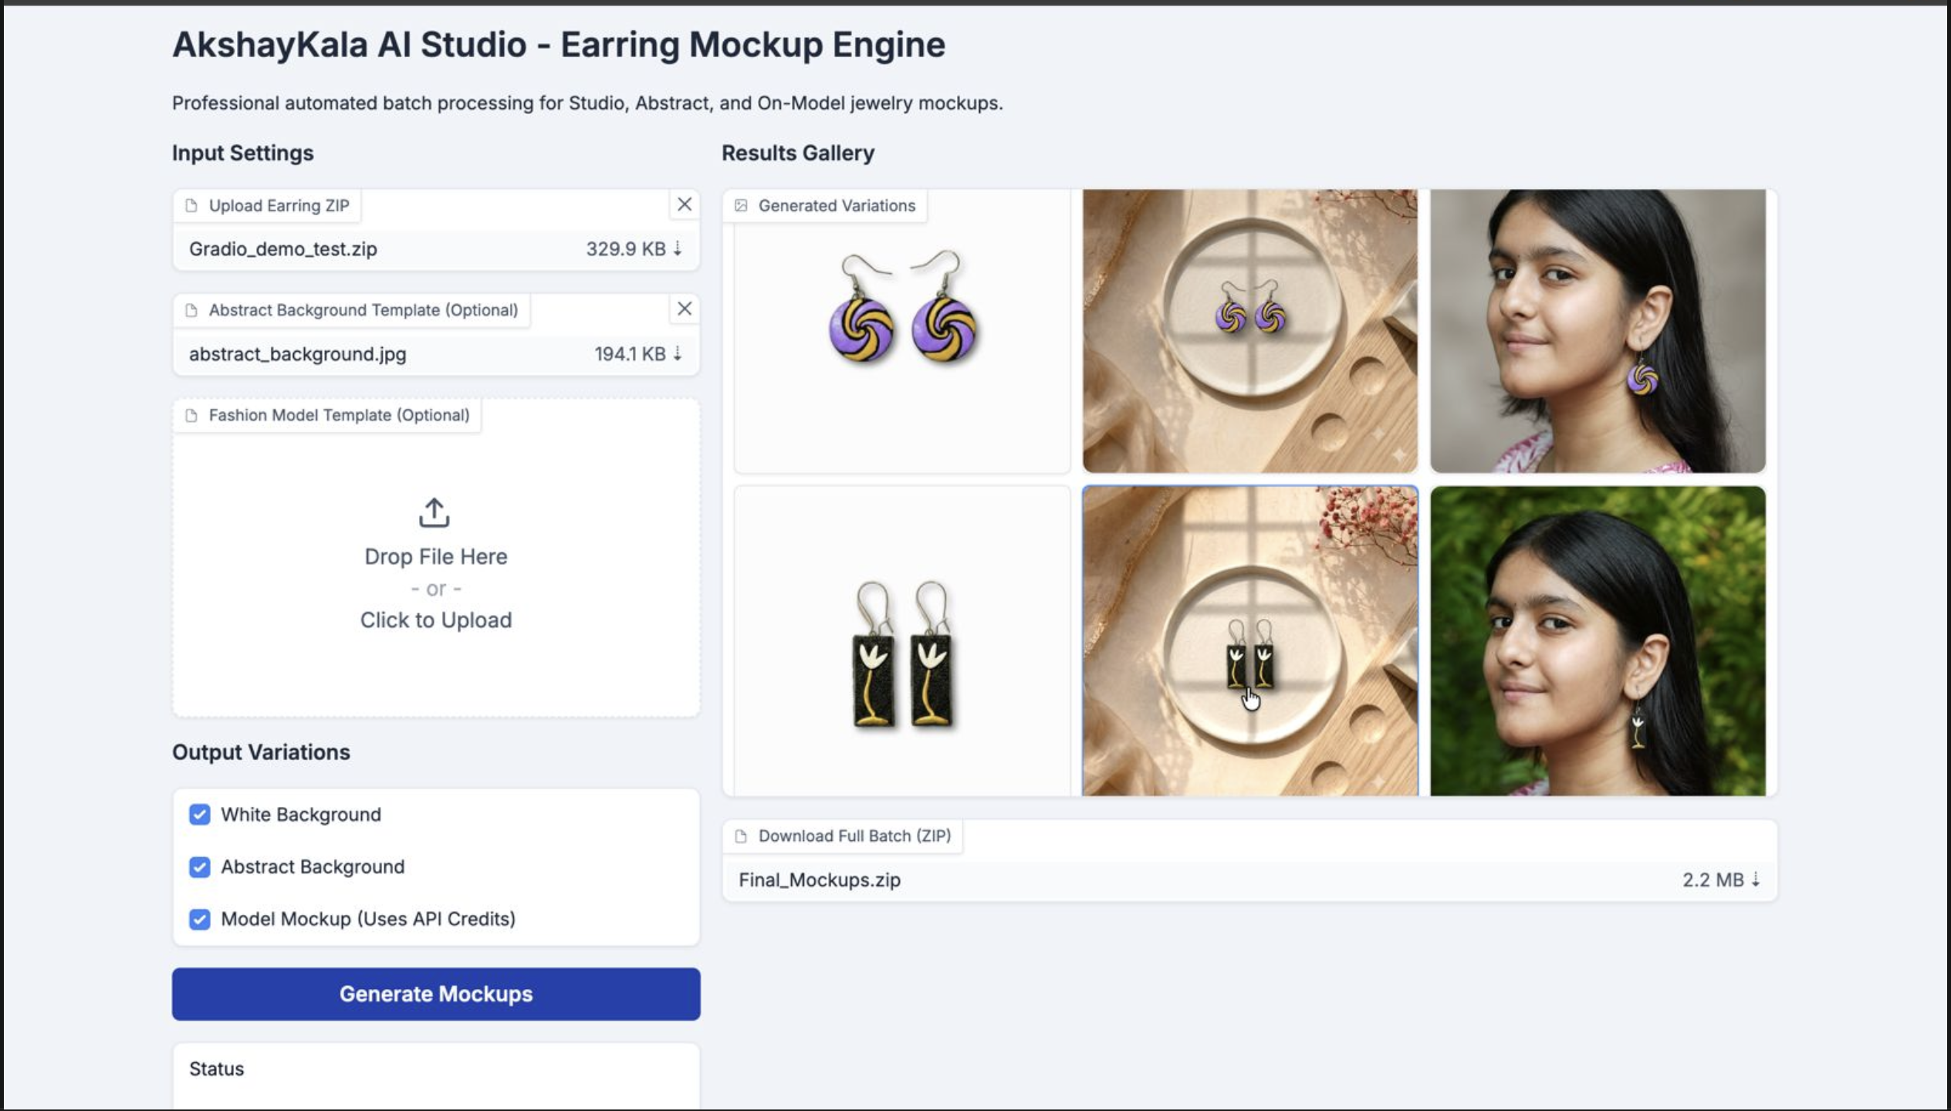
Sankalp Samarth
AkshayKala AI Studio

Slide 5
The Technical Framework
Computer Vision Pipeline (Common to all 3 outputs):
Raw Image
Segmentation
Alpha Matte
Cropped Cutout
Image Segmentation
separates earring from background
Alpha Matting
soft transparency, not a hard cutout
Bounding Box Cropping
cv2.findNonZero + cv2.boundingRect
ISNet
preserves fine chains and hooks better than U-2-Net
C = αF + (1−α)B
trims dead transparent space
fg 200 / bg 10 / erode 0
Sankalp Samarth
AkshayKala AI Studio
Notes:
[Sources]
- User-provided technical narrative and implementation parameters.

Slide 6
Output 1: White Studio Background
A controlled product shot, built from the shared cutout
Cutout
Neutral Canvas
Scale
Sharpen
Shadow
Canvas Compositing
RGB 252, 252, 252
Aspect ratio preserved
Unsharp Masking
radius 2 • amount 150 • threshold 3
LIGHT
Lanczos Resampling
high-quality sinc-based scaling
Drop Shadow Simulation
alpha × darkness → GaussianBlur → offset
Sankalp Samarth
AkshayKala AI Studio
Notes:
[Sources]
- User-provided technical narrative and implementation parameters.

Slide 7
Output 2: Find the Placement Surface
Auto Plate Detection isolates a stable compositing region
BACKGROUND PHOTO
CANNY EDGES + DILATE
FINDCONTOURS
Contour Area Filtering
rejects noise, keeps the dominant plate
Sankalp Samarth
AkshayKala AI Studio
Notes:
[Sources]
- User-provided technical narrative and implementation parameters.

Slide 8
Output 2: Make the Composite Belong
Color and light cues bind the earring to the scene
Ambient Color
Harmonization
Edge
Darkening
Luminance-based
Shadow Mapping
C′ = (1−λ)C + λA
soft rim attenuation
anchors the cutout boundary
darker scene regions cast stronger contact shadows
blend product color toward local ambient
Ambient Occlusion
contact shading used by 3D rendering engines
Sankalp Samarth
AkshayKala AI Studio
Notes:
[Sources]
- User-provided technical narrative and implementation parameters.

Slide 9
On-model Mockup: Two Strategies
One production track, one long-term R&D track
STRATEGY A / PRODUCTION
STRATEGY B / R&D
Generative API
Local Diffusion
Claid.ai MLaaS endpoint
CDN → REST job → polling → result
Constrained prompt guidance
Stable Diffusion foundation
LoRA + DreamBooth adaptation
Inpainting + ControlNet conditioning
speed to ship • consistent output
control • self-hosting • no credit cost
Sankalp Samarth
AkshayKala AI Studio
Notes:
[Sources]
- User-provided technical narrative and implementation parameters.

Slide 10
Strategy A: Production API Orchestration
External inference, coordinated as an asynchronous job
CDN Staging
Uguu.se
REST Job
Submission
Async Polling
5s × 60
Result
Download
pending → processing → succeeded
MLaaS
Claid.ai Fashion Models API as the inference endpoint
Prompt Engineering for Constrained Generation
lobe-relative scale • single-ear visibility • shape and texture preservation
inference-time guidance: shaping model output without retraining
Sankalp Samarth
AkshayKala AI Studio
Notes:
[Sources]
- User-provided technical narrative and implementation parameters.

Slide 11
Strategy B: Local Diffusion
Adapt the subject, constrain the region, preserve the pose
LoRA
ΔW = A × B
Inpainting
masked region generation
Stable Diffusion
latent-space denoising by a U-Net
low-rank update
compute and VRAM efficient
DreamBooth
rare token binds the earring
ControlNet
pose + depth conditioning
forward noising → reverse denoising
Fully self-hosted, infinitely customisable
Sankalp Samarth
AkshayKala AI Studio
Notes:
[Sources]
- User-provided technical narrative and implementation parameters.

Slide 12
Fidelity vs. Contextual Realism
Small jewelry details are easy for diffusion models to reinterpret
SUBJECT FIDELITY
shape • texture • scale
CONTEXTUAL REALISM
pose • light • skin contact
SMALL OBJECT
TENSION
Risk: hallucinated hooks, stones, or proportions
CONDITIONING RESPONSE
LoRA + DreamBooth
Inpainting Mask
ControlNet Pose / Depth
Sankalp Samarth
AkshayKala AI Studio
Notes:
[Sources]
- User-provided technical narrative and implementation parameters.

Slide 13
Two Tracks, One System
Production now, deeper control next
STRATEGY A / API
STRATEGY B / DIFFUSION
Strategy A (API) gave us production-ready, consistent results immediately.
Strategy B (Diffusion) represents the long-term R&D direction: a fully self-hosted, infinitely customisable pipeline with no API dependency or credit cost.
The technical groundwork we laid with LoRA and DreamBooth is the foundation for the next iteration of this system.
Speed to ship
Immediate reliability + long-term ownership
Sankalp Samarth
AkshayKala AI Studio
Notes:
[Sources]
- User-provided technical narrative and implementation parameters.

